Slide 1

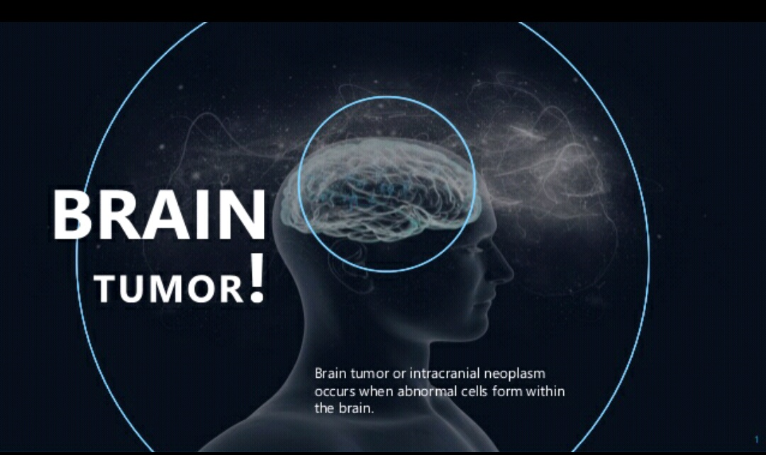
Ece(1004) - signals and systems
BRAIN TUMOR DETECTION
Review - 1
Team Members:
K.Madhu Swapnika – 17BLC1024
A.Rohitha – 17BLC1007
Under the professor- Dr.Mohan Prasad sir

Slide 2
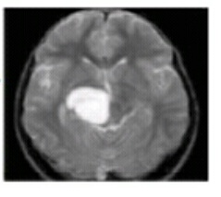
INTRODUCTION
The BRAIN is the most important part of the central nervous system
A Tumor is a mass of tissue that is formed by an accumulation of abnormal cells
Brain Tumor occurs because the normal metabolism of cells stop. Some cells may not die and new cells grow.
The main task of the doctors is to detect the tumor which is a time consuming for which they feel burden.
The only optional solution for this problem is the use of ‘Image Segmentation’.
Figure:
Example of an MRI showing the presence of tumor in Brain

Slide 3
OBJECTIVE
Our main Objective of imaging of BRAIN TUMOR
– is to extract meaningful and accurate information from
these images with least error possible.
To detect the size and location of the Brain Tumors from the magnetic resonance images
The segmentation of the Brain tissue in the magnetic resonance imaging is also very important for detecting the existence and outlines of Tumors.
Finally conclude whether it’s a Tumor image or Not.

Slide 4
ALGORITHM USED FOR DETECTION OF TUMOR
STEP 1: Input the image.
STEP 2: Convert the RGB image to grey.
STEP 3: Use the filters for removing noise and perform subtraction operation and form histogramic equivalent for Contrast enhancement .
STEP 4: Apply Watershed Segmentation for tumor detection .
STEP 5: Perform morphological operations for calculating Area, Mean ,Standard Deviation.

